Slide 1
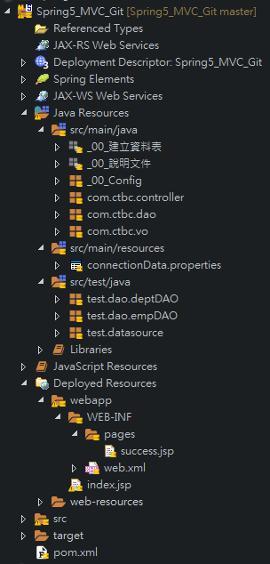

Spring 5 MVC – 零XML
目錄結構
代替web.xml & contextLoaderListener
Spring 後端Bean設定
Spring MVC 設定 (ViewResolver …etc)

Slide 2
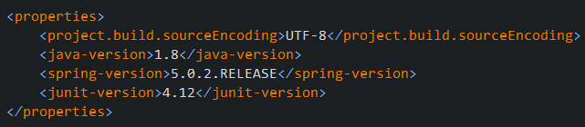
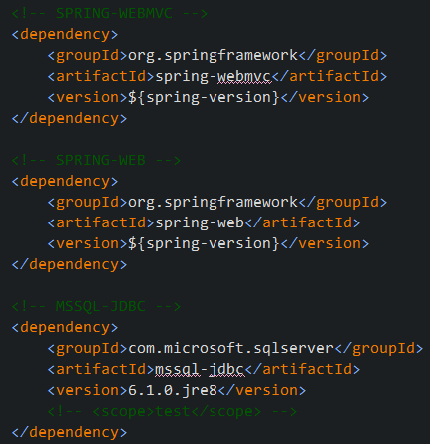
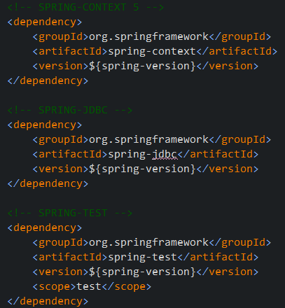
Spring 5 MVC – 零XML
POM

Slide 3
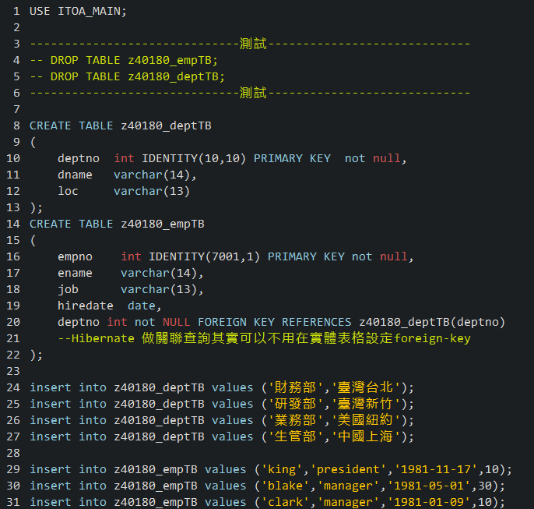
Spring 5 MVC – 零XML
TABLE

Slide 4
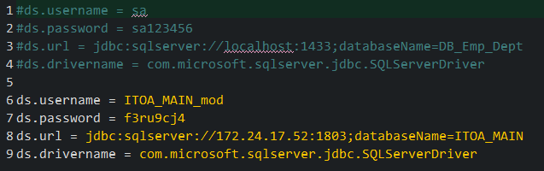
Spring 5 MVC – 零XML
connectionData.properties

Slide 5
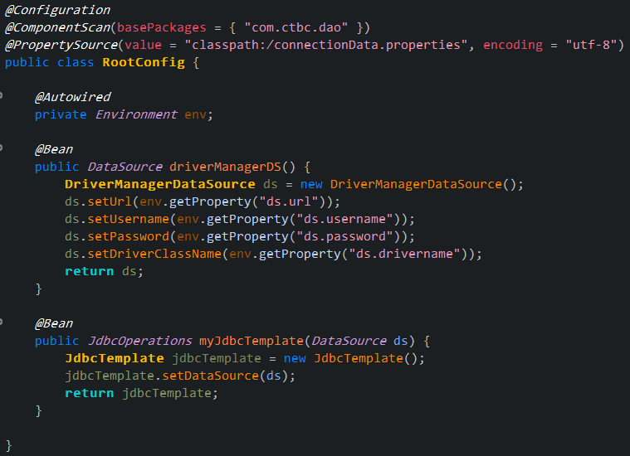
Spring 5 MVC – 零XML
RootConfig.java

Slide 6
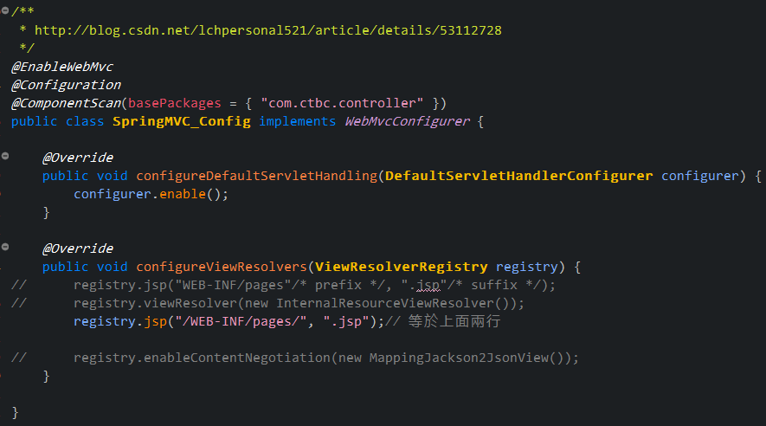
Spring 5 MVC – 零XML
SpringMVC_Config.java

Slide 7
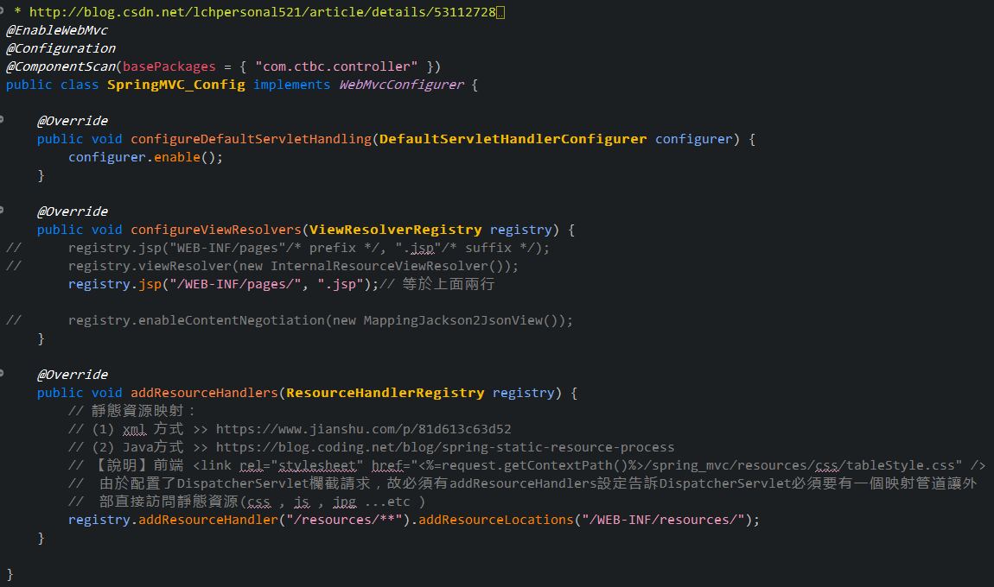
Spring 5 MVC – 零XML
SpringMVC_Config.java
要讓此url先過DispatcherServlet
將以resources打頭的請求映射到

Slide 8
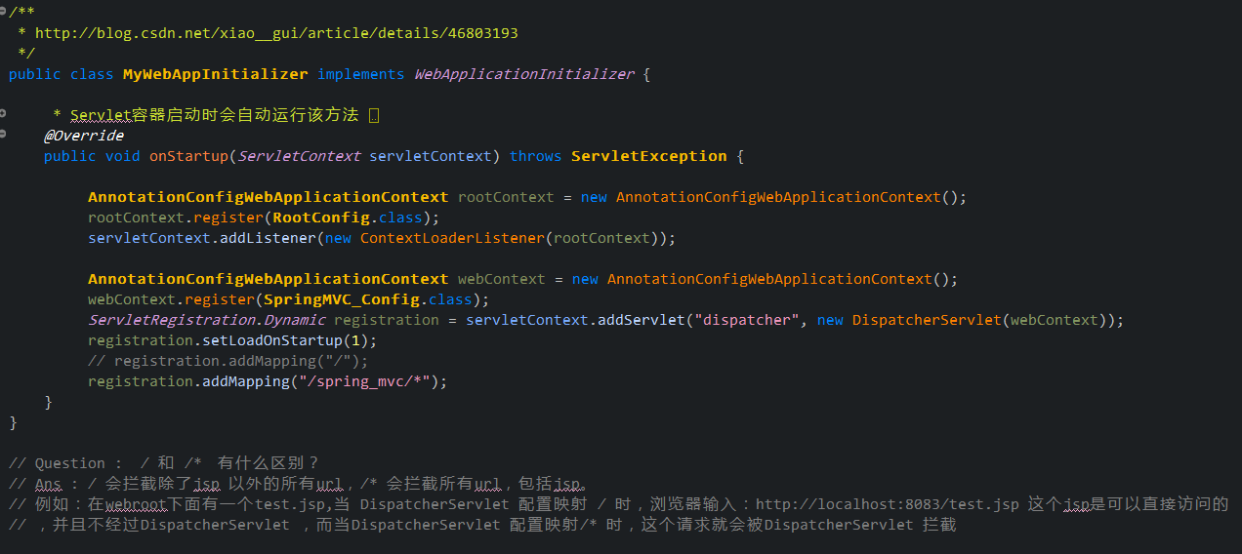
Spring 5 MVC – 零XML
MyWebAppInitializer.java
spring_mvc/ 打頭的請求才會被 dispatcherServlet 攔截

Slide 9
VO

Slide 10
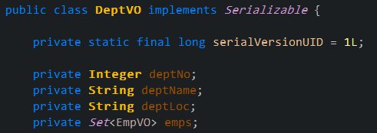
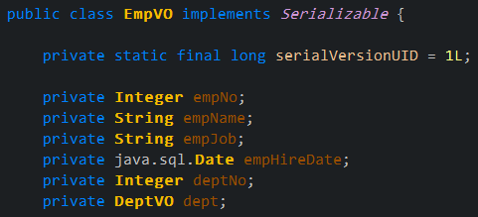
Spring 5 MVC – 零XML
VO

Slide 11
DAO JdbcTemplate

Slide 12
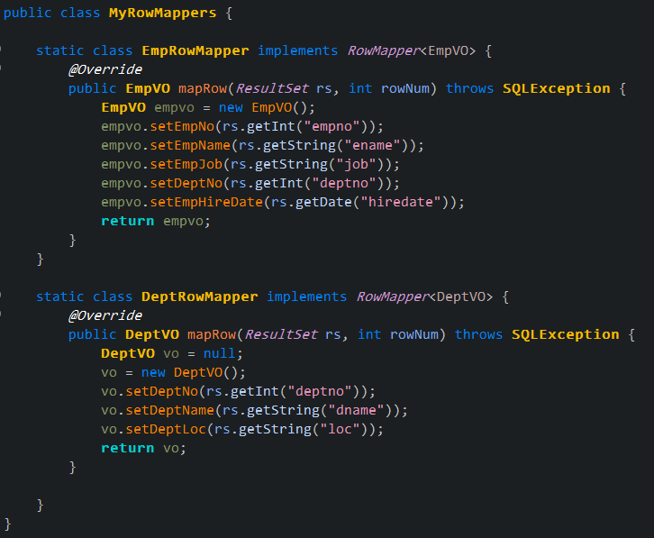
Spring 5 MVC – 零XML
MyRowMappers.java
將RowMapper 整理在一支類別

Slide 13
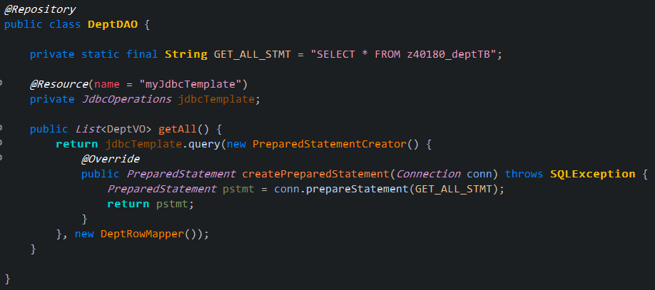
Spring 5 MVC – 零XML
DeptDAO

Slide 14
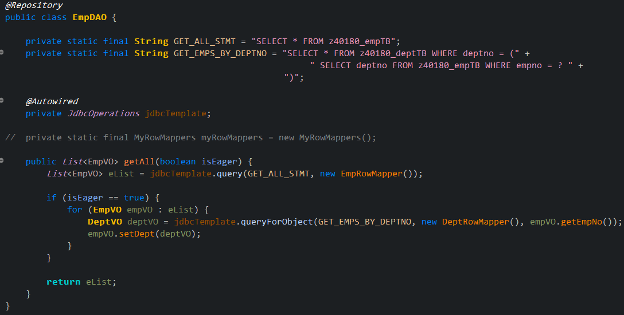
Spring 5 MVC – 零XML
EmpDAO
手動Lazy-loading

Slide 15
Controller Spring MVC

Slide 16
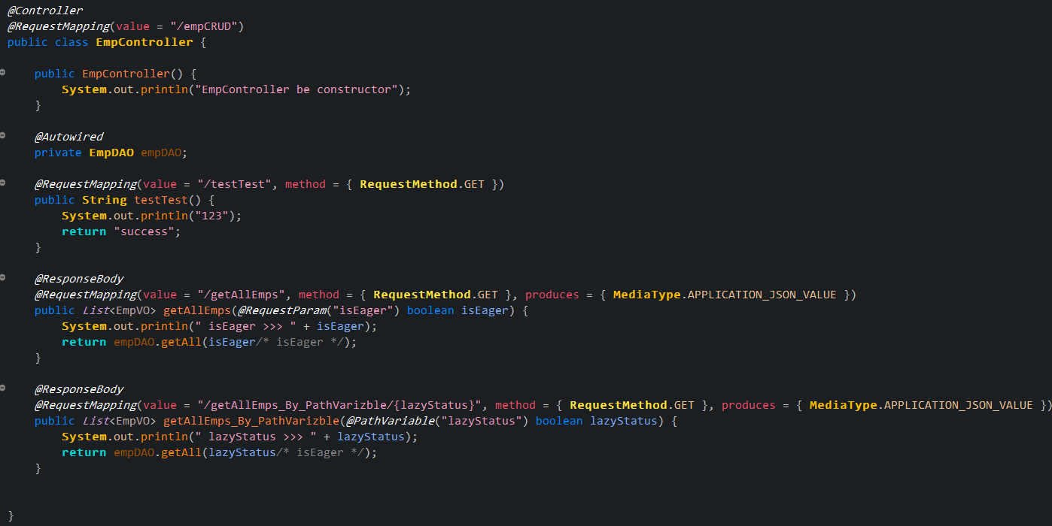
Spring 5 MVC – 零XML

Slide 17
JUNIT TEST

Slide 18
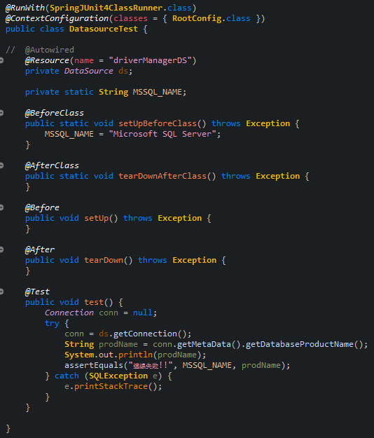
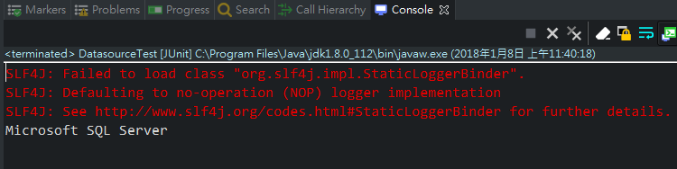
Spring 5 MVC – 零XML
DatasourceTest.java

Slide 19
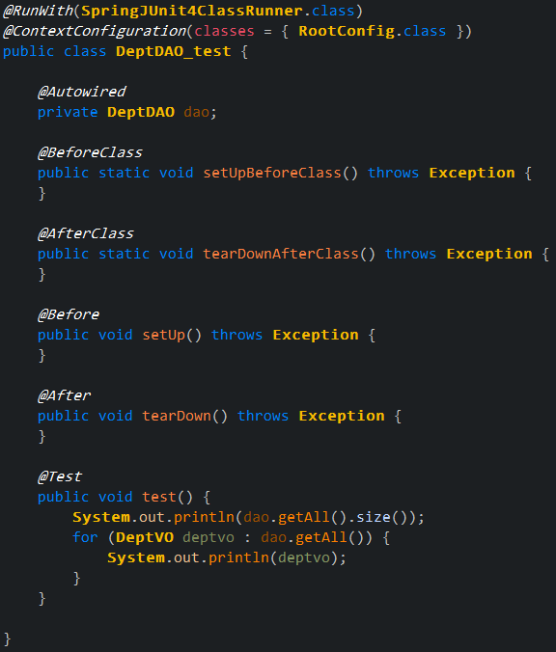
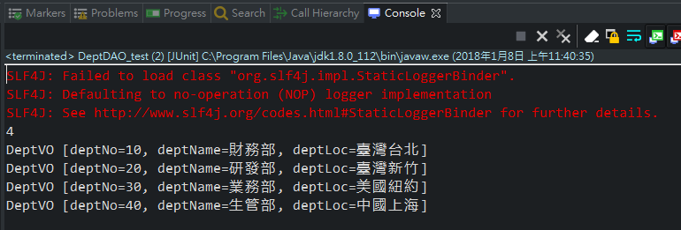
Spring 5 MVC – 零XML
DeptDAO_test.java

Slide 20
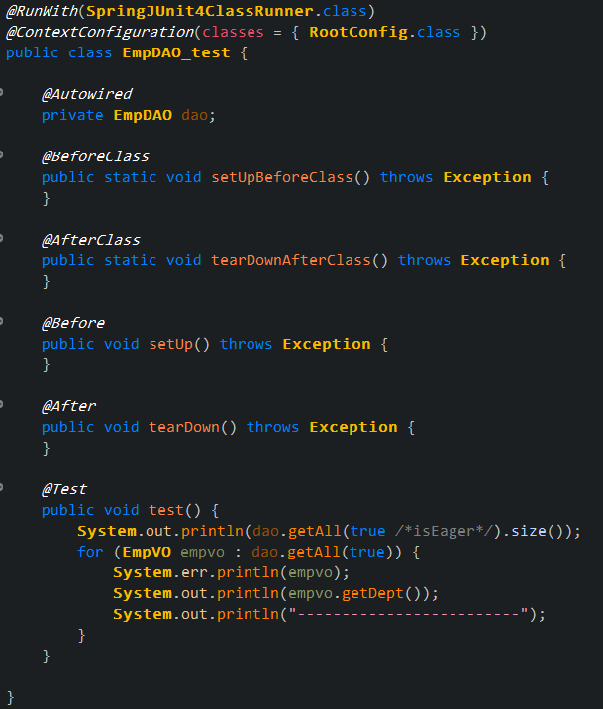
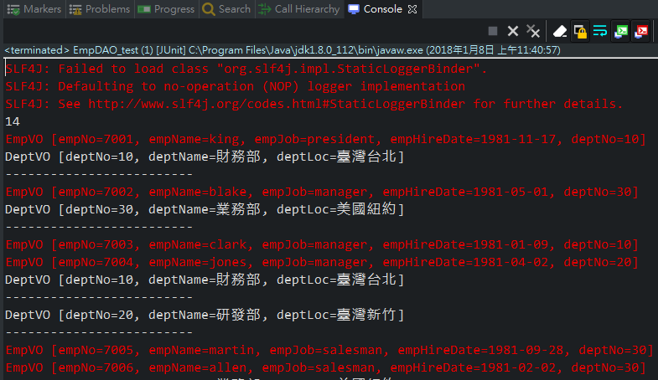
Spring 5 MVC – 零XML
EmpDAO_test.java

Slide 21
jsp

Slide 22
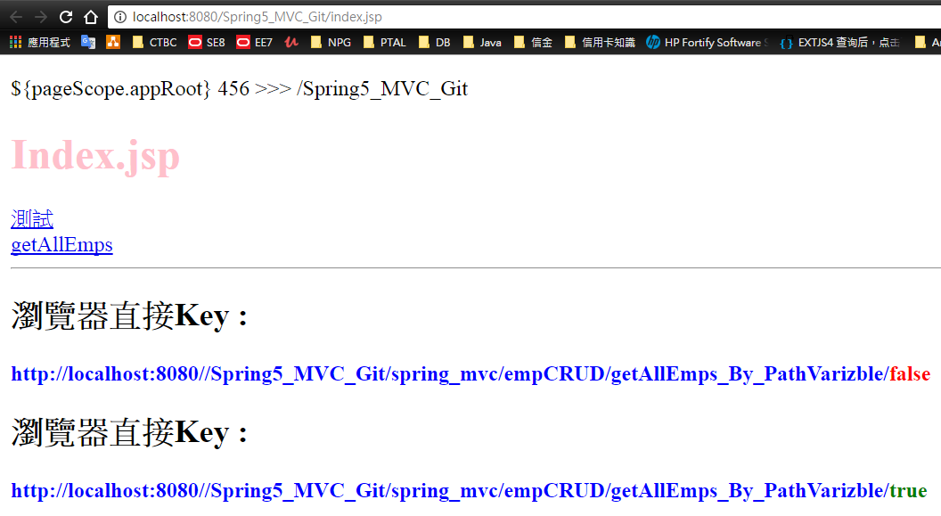
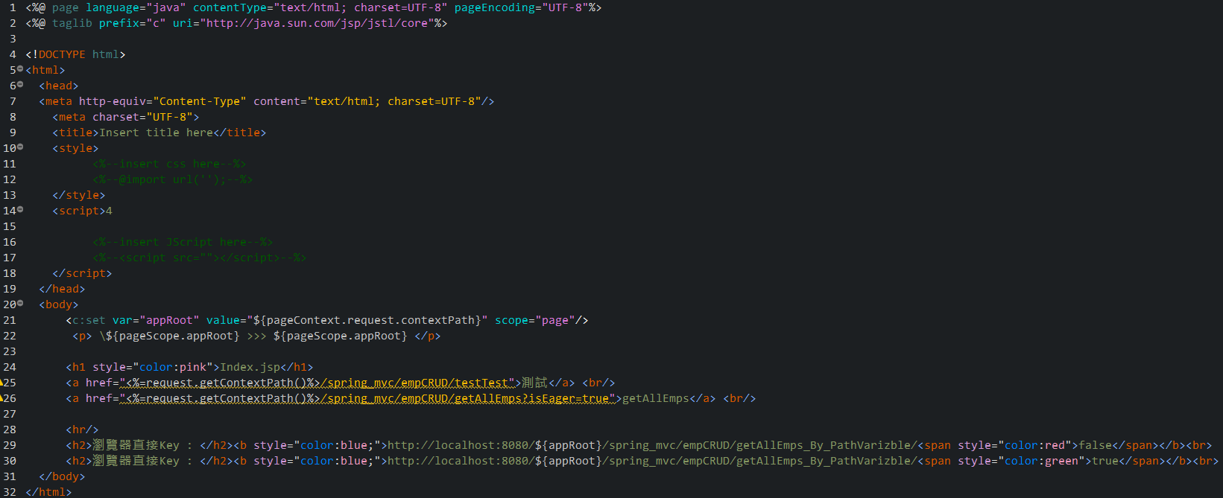
Spring 5 MVC – 零XML
index.jsp

Slide 23
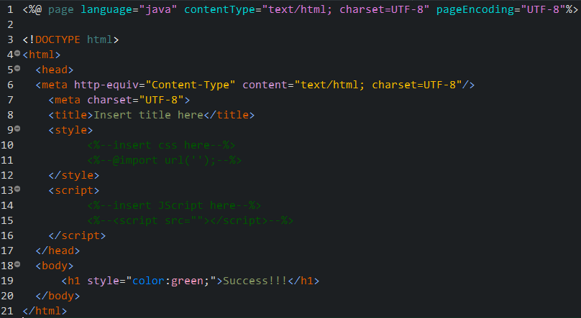
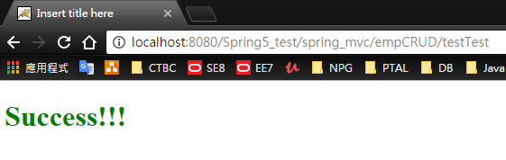
Spring 5 MVC – 零XML
success.jsp

Slide 24
Jsp 測試

Slide 25
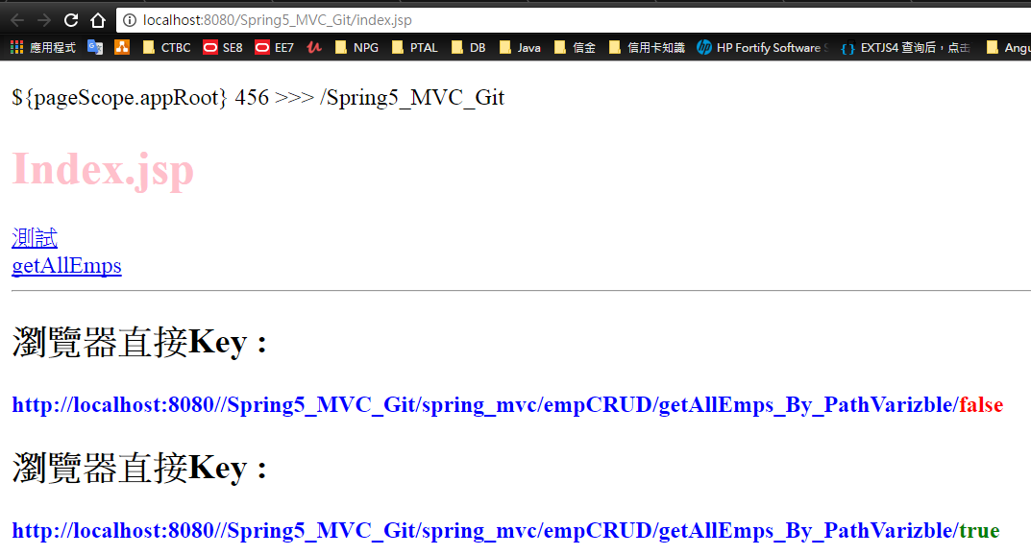
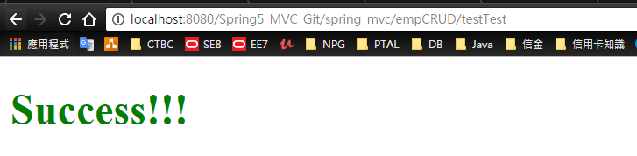
Spring 5 MVC – 零XML

Slide 26
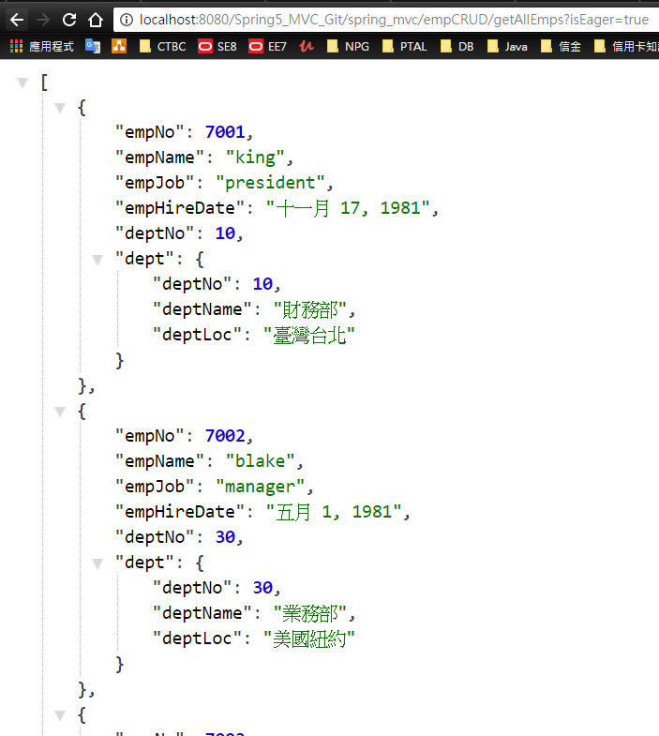
Spring 5 MVC – 零XML

Slide 27
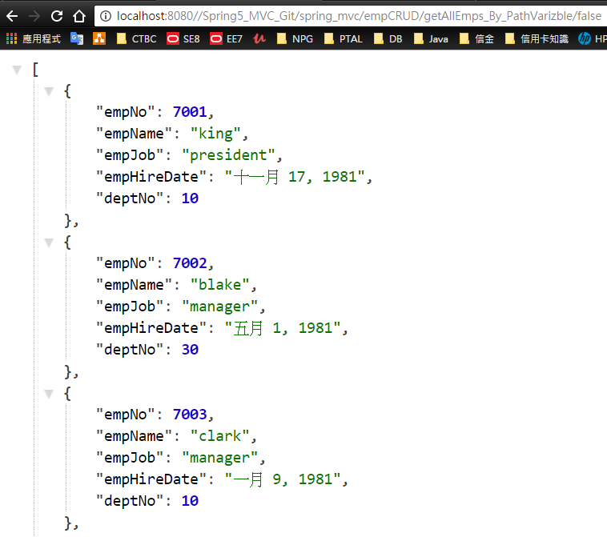
Spring 5 MVC – 零XML

Slide 28
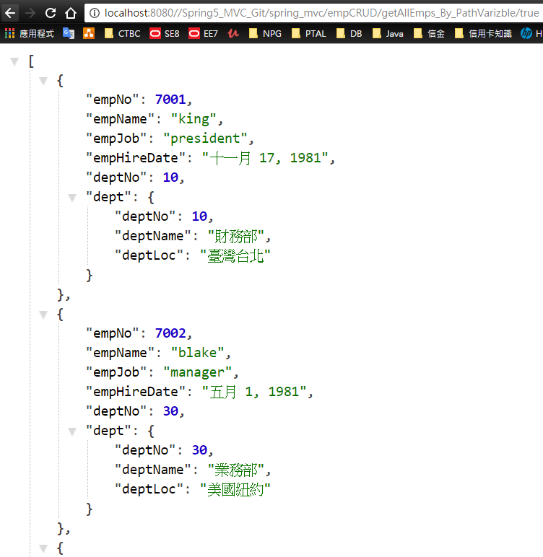
Spring 5 MVC – 零XML

Slide 29
附錄

Slide 30
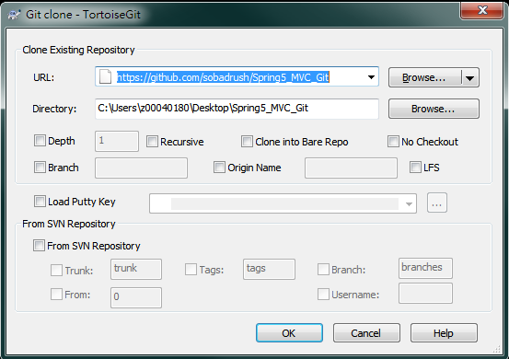
檔案 - GitHub
https://github.com/sobadrush/Spring5_MVC_Git

Slide 31
檔案

Slide 32
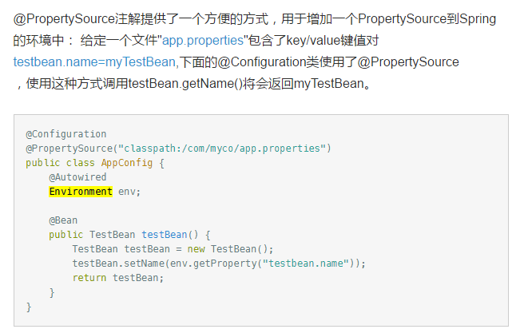
附錄
https://www.jianshu.com/p/49e950b0b008

